Slide 1
Inpatient Rehabilitation Services at
Shriners Hospitals for Children—Springfield
Medical Home Meeting
9/11/18

Slide 2
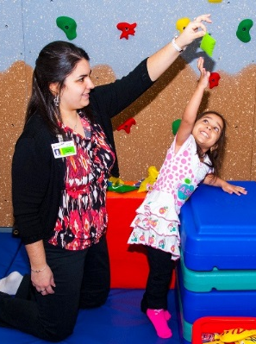

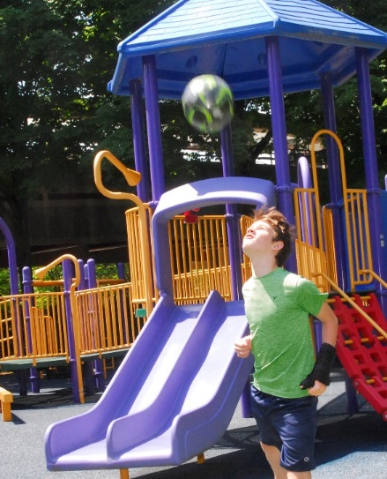
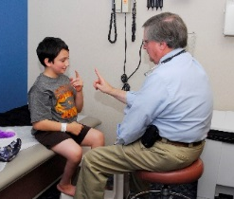

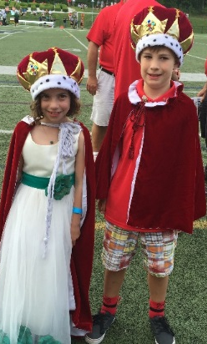
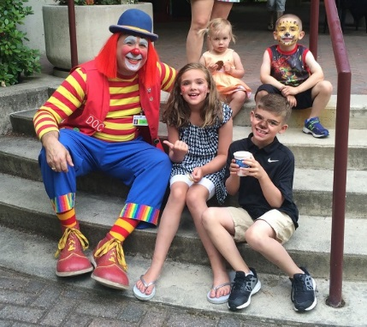
2016-2020 Strategic Vision
Develop the market-leading pediatric orthopaedic program in Western Massachusetts
Strengthen Core Services
  Orthopaedics
  Complex spine
  Neuromuscular
  Chest wall deformity
  Cleft lip and palate
  Rheumatology
Expand Specialty Services
  Complex spine care
  Sports health and medicine
  Developmental medicine
  Fracture care clinic
  Pediatric urology program
  Inpatient rehabilitation
Sana with Stefanie
Lilah Mae
Jacob
Austin with Dr. Kaplan
Fei Fei
Jayden, Zachary, Anna, Danny & Doc
Giavanna & Justin

Slide 3
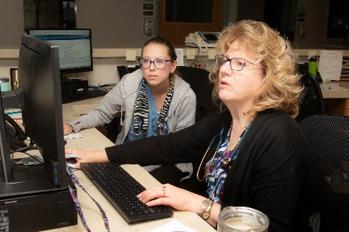
Inpatient Rehabilitation

Slide 4
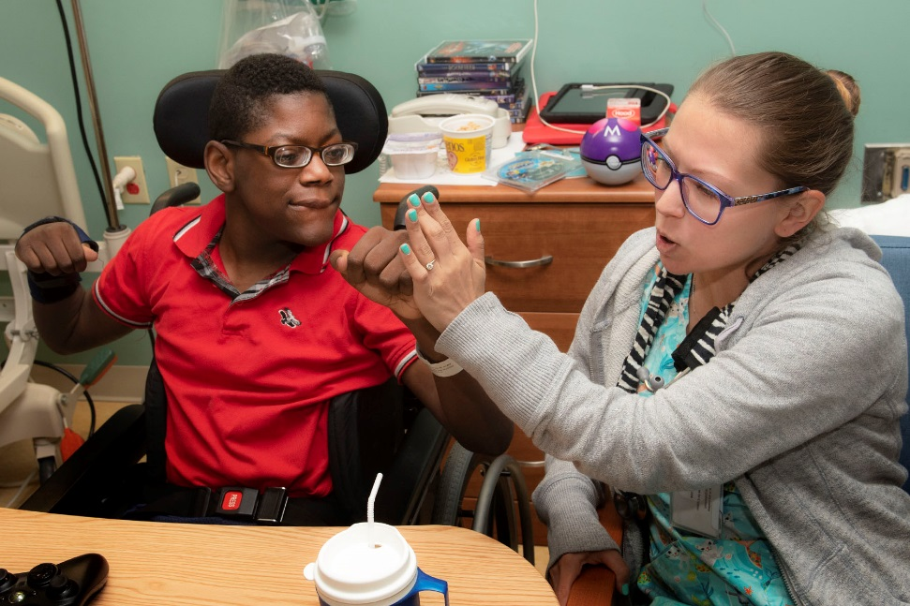
Admission Criteria
Medically stable
Up to 18 years (considered on a case-by-case basis)
Orthopaedic conditions
  Post-operative physical dysfunction of cerebral palsy
  Scoliosis, Blount’s disease, fractures, dislocations, slipped capital femoral epiphysis, leg length discrepancy, amputations
Neuromusculoskeletal conditions
Spinal cord injury
Pediatric stroke
Brain tumors
Brain injuries
Meningoencephalitis
Central nervous system
Complex surgical conditions
Juvenile rheumatoid arthritis

Slide 5
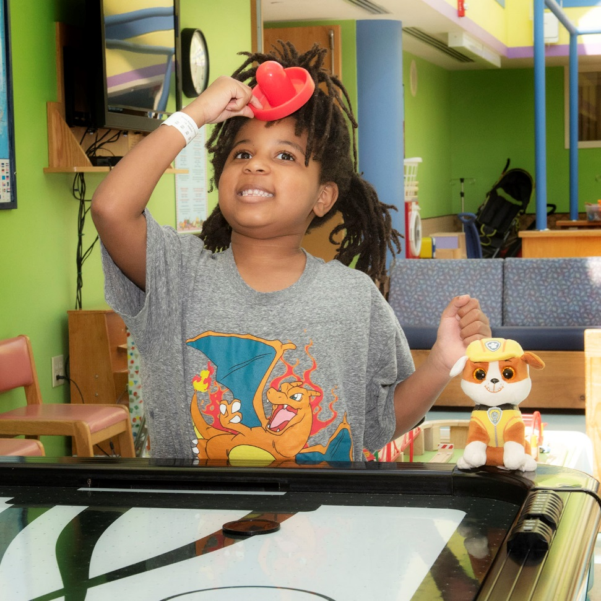
Clinical Exclusions
Newborns
Children on vents
New tracheostomies
Total parenteral nutrition
Central lines
Chemotherapy

Slide 6
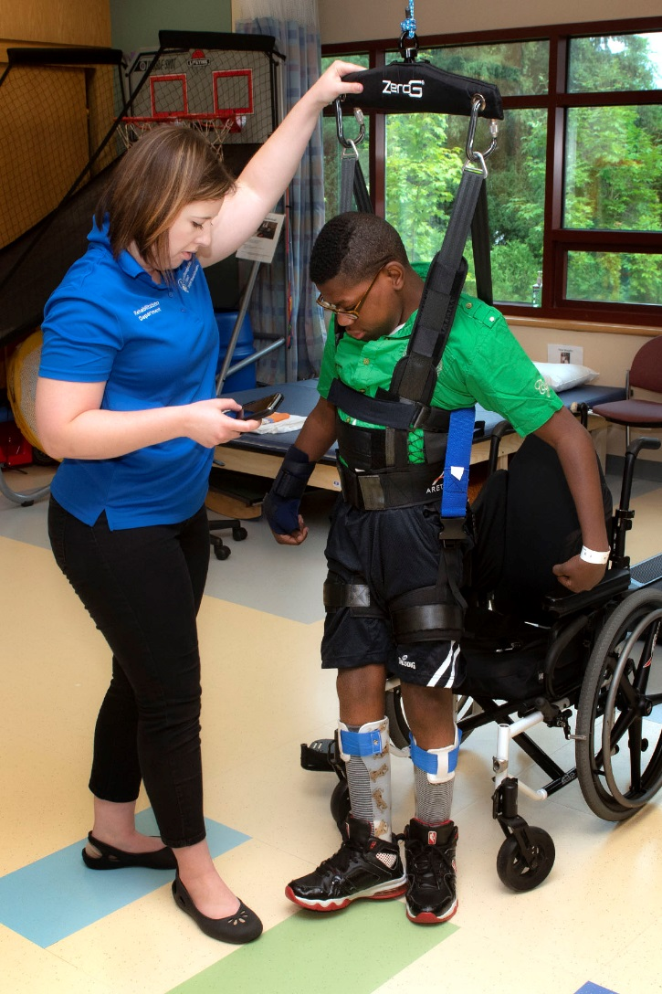
Program Focus & Goals
  Program Focus:
    Intensive therapy
    24/7 rehab nursing and medical care
    Interprofessional team approach
  Program Goals:
    Improve functional independence
    Patient and family education
    Transition to community

Slide 7
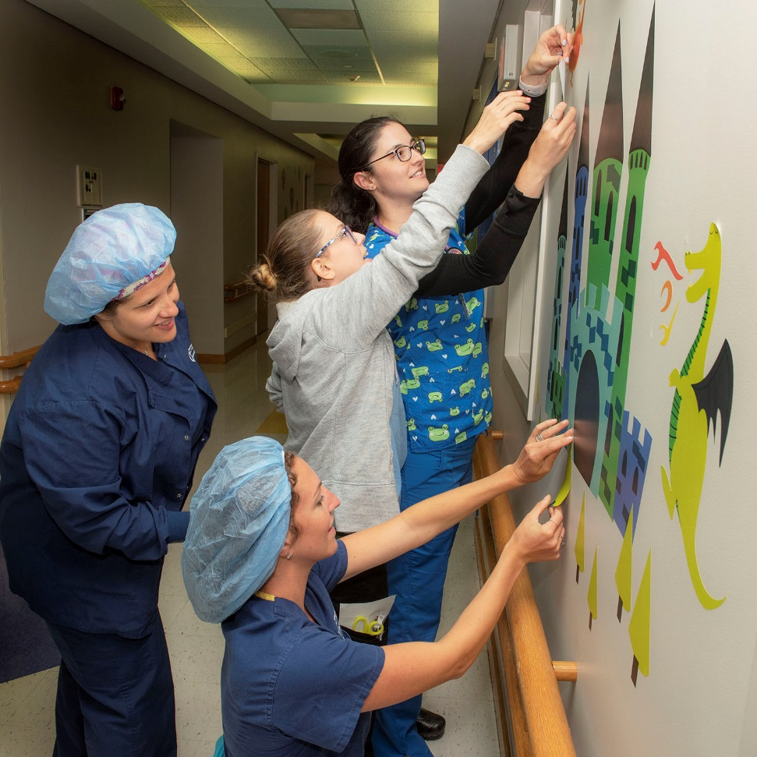
Multidisciplinary Team Care
Nursing
Physical Medicine and Rehabilitation
Physical therapy
Occupational therapy
Speech therapy
Child life
Orthotics and Prosthetics
Psychology
Social services
Nutrition

Slide 8
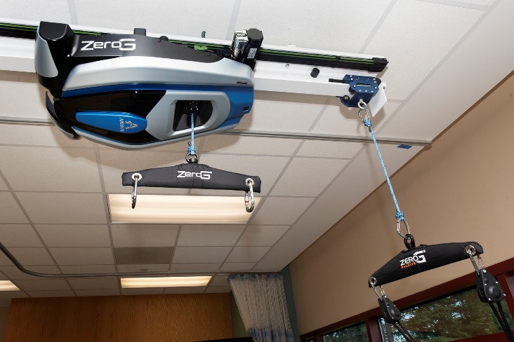
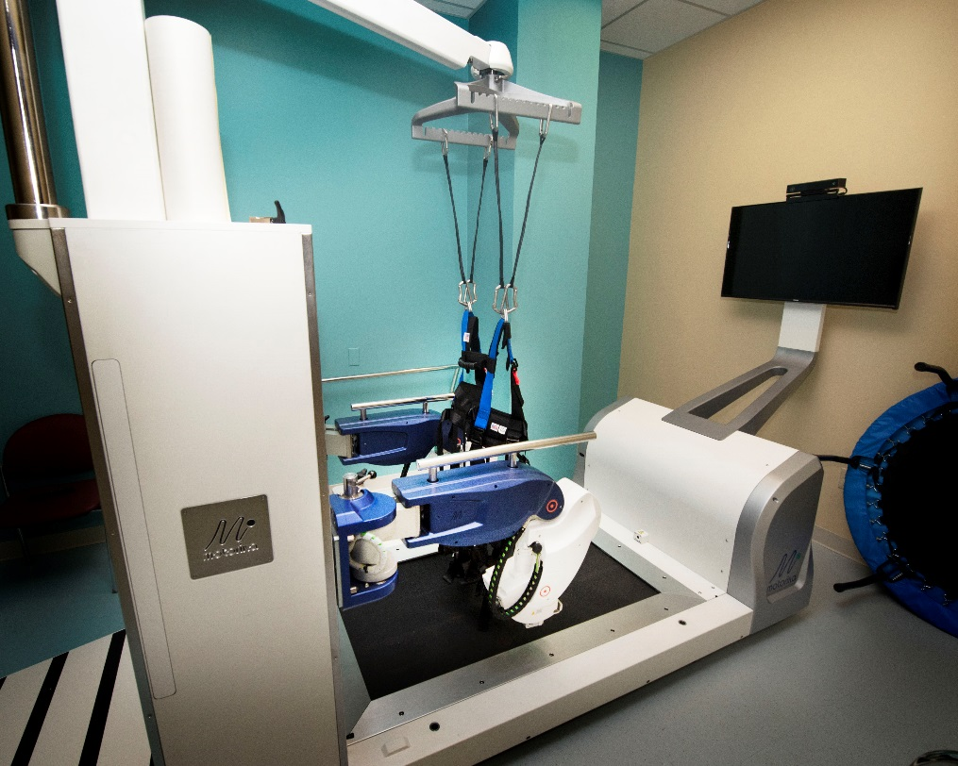
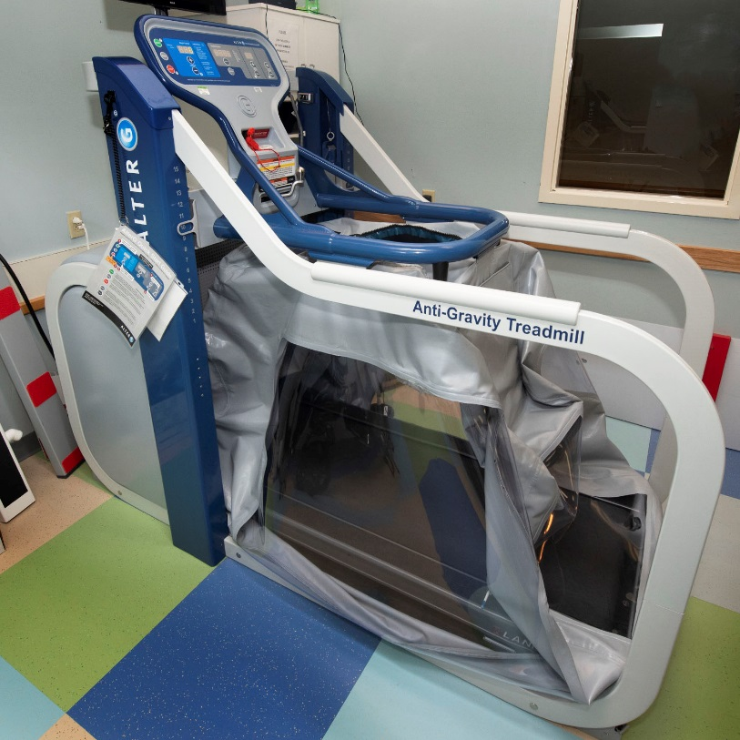
State-of-the-Art Technology
Partial body-weight support training via the ReoAmbulator robotic treadmill system, ZeroG walkway, and AlterG anti-gravity treadmill systems, supplemented by RT300 functional electrical stimulation and additional therapy equipment across the continuum of functional ability.

Slide 9
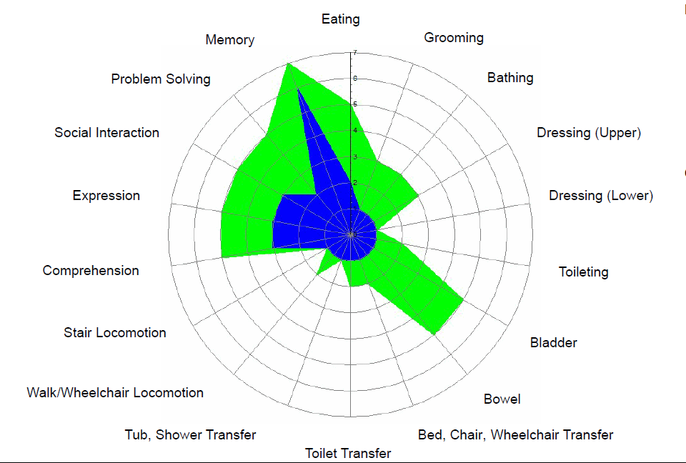
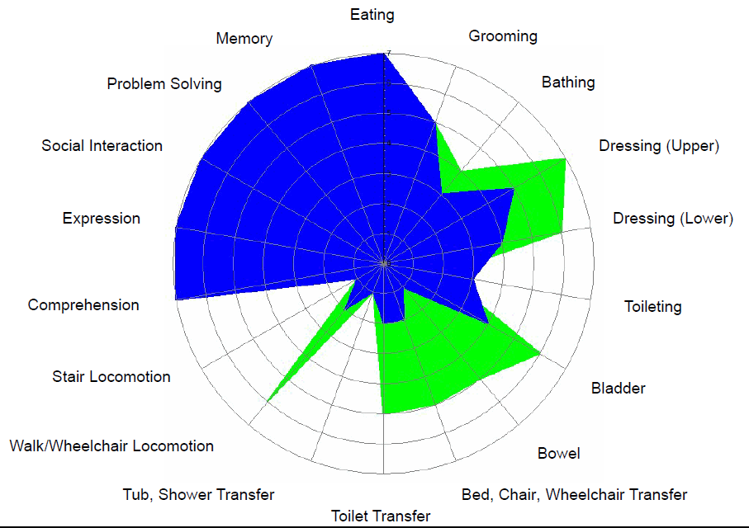
WeeFIM
JD
JA
LOS=25 | Adm | Dsg | Eff
Self-care | 9 | 29 | 0.80
Mobility | 5 | 8 | 0.12
Cognition | 17 | 22 | 0.20
Total | 31 | 62 | 1.24
LOS=5 | Adm | Dsg | Eff
Self-care | 32 | 42 | 2.00
Mobility | 8 | 18 | 2.00
Cognition | 35 | 35 | 0.00
Total | 75 | 95 | 4.00

Slide 10
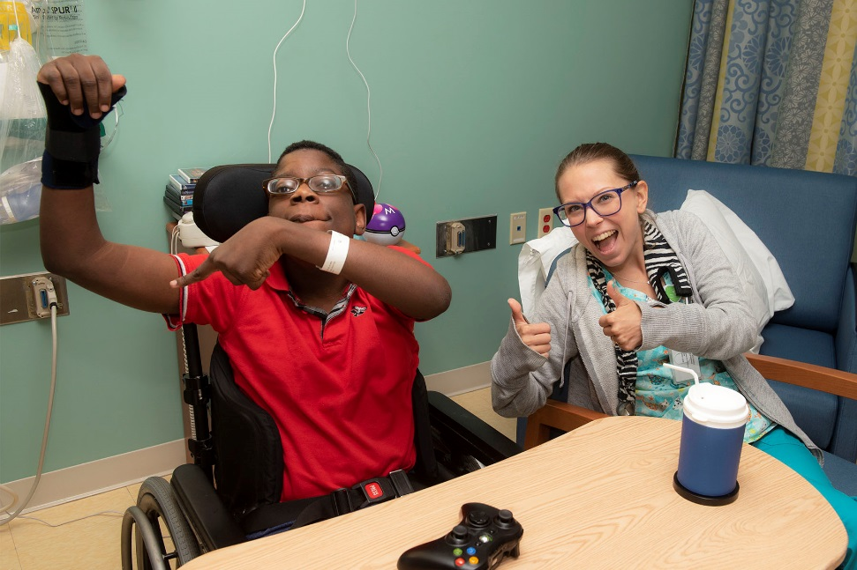
Case Study 1 - JD
14yr old with quadriplegic CP
Admit from home via referral by orthopaedic surgeon for declining function following fracture
Poor self care and mobility on admission

Slide 11
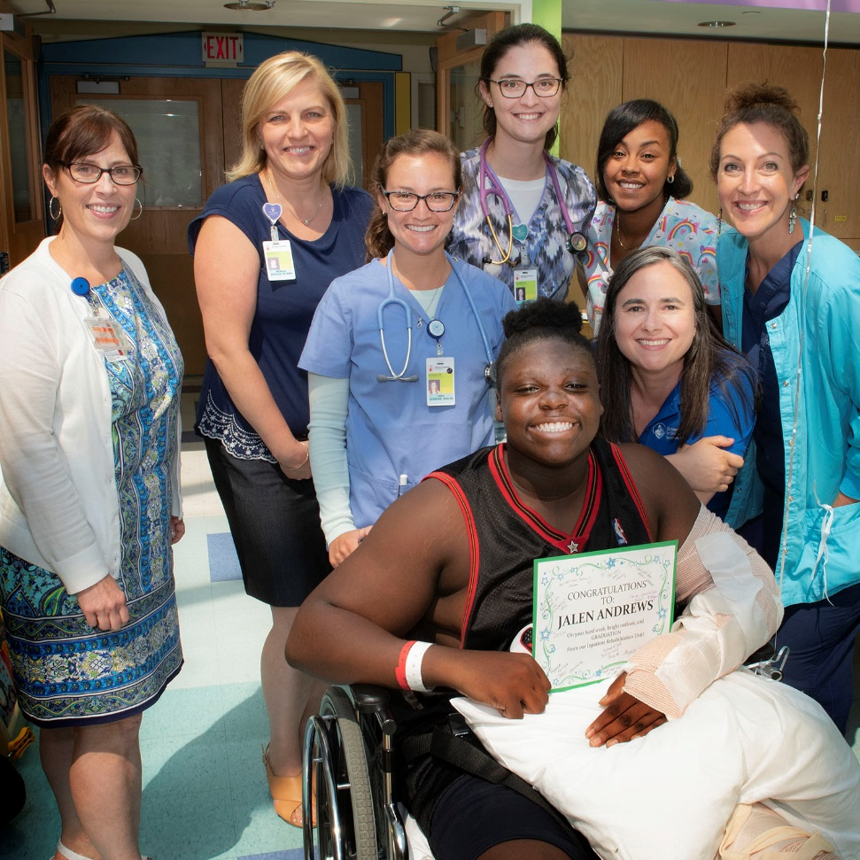
Case Study 2 - JA
14yr old with multiple fractures
Admit from Baystate Medical Center prior to return home
Poor mobility and self-care on admission

Slide 12
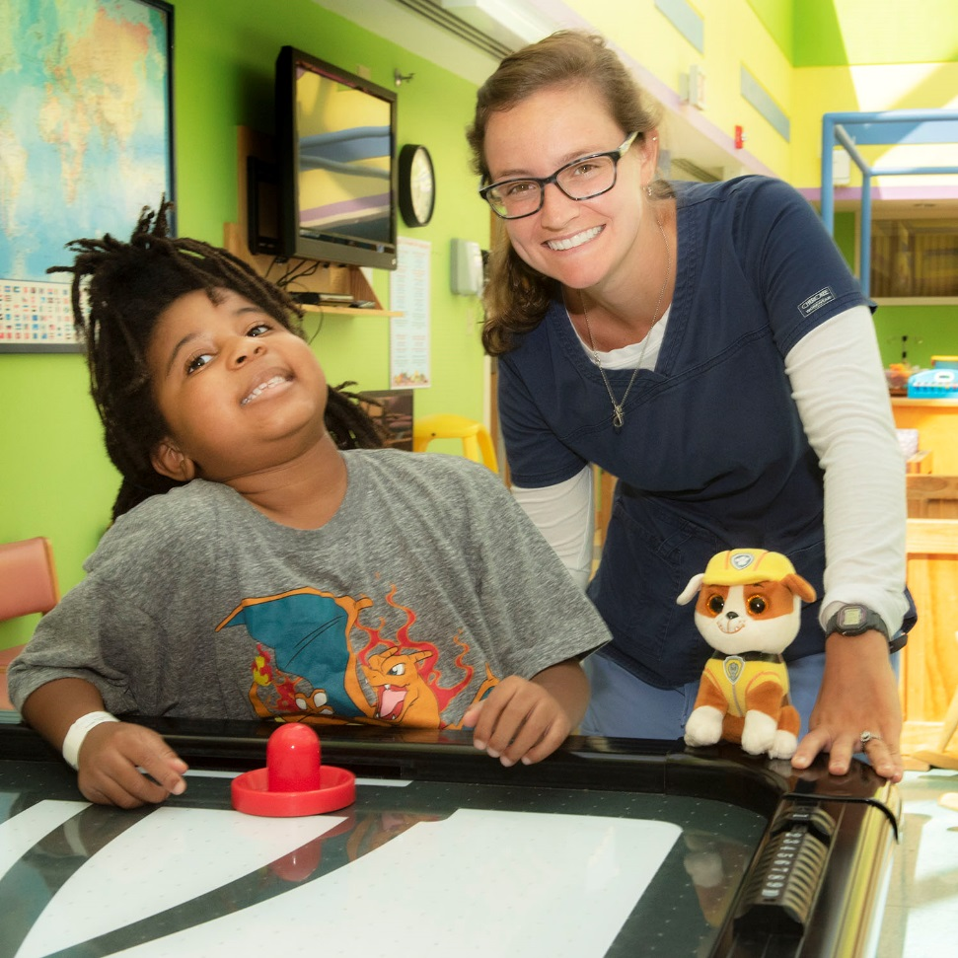
Case Study 3 - ZW
5yr old with acute disseminated encephalomyelitis (ADEM)
Admit from Boston Children’s Hospital prior to return home
Poor mobility, balance, and cognition, some self-care needs on admission

Slide 13

Case Study 4 - RA
16yr old with anoxic brain injury, s/p major burns 30%
Collaboration BOS-SPR
Transfer from another pediatric IRF; insurance cutoff; vs transfer to SNF
Poor mobility and self-care from burns, ADLS and IADLs from brain injury on admission

Slide 14

Accreditation
TJC/CMS/DPH
Certifications
CARF
  Commission for the Accreditation of Rehabilitation Facilities
  Quality, value, outcomes
  Standards
  Year 2 goal
    1 year documentation to meet standards
    Compliance for 6 months

Slide 15

Queries?
Questions?
Quibbles?
Comments?
Qualms?
Quips?

