Slide 1
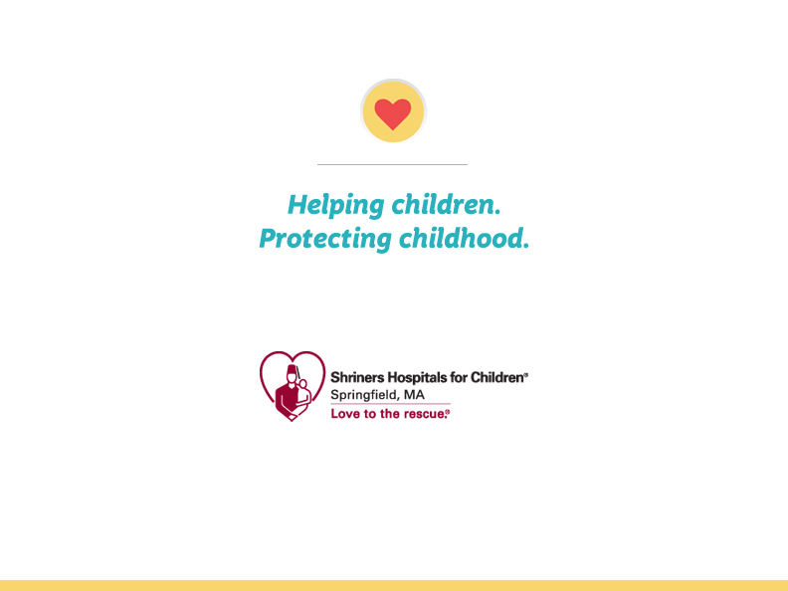

Slide 2
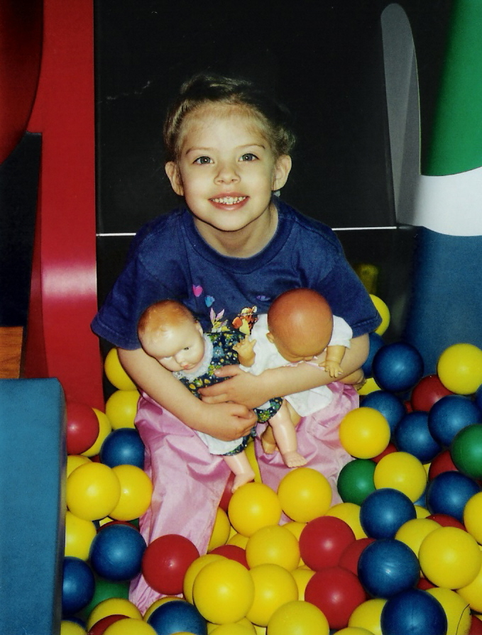
Inpatient vs Outpatient Rehabilitation
Benefits to both in for the correct diagnosis and correct phase in treatment

Slide 3
Pediatric Rehabilitation
Children are not small adults
Children have adults as guardians and some adults may have their children as guardians.
Goals for adults are not the same for children

Slide 4
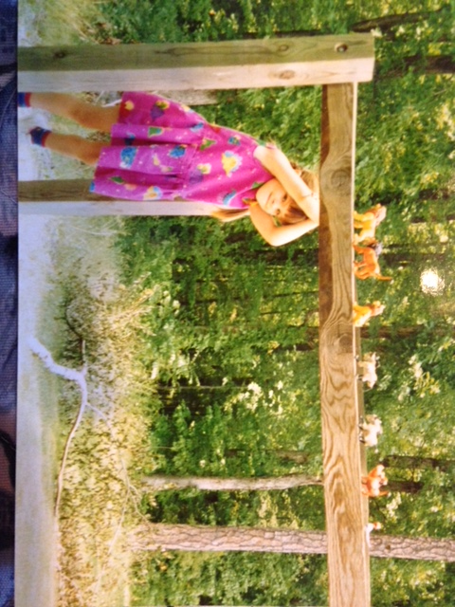
Goals for Children

Slide 5
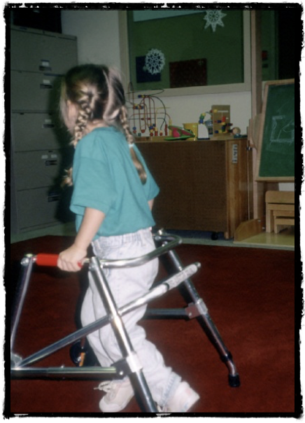
Inpatient Therapy

Slide 6

Teens and independence

Slide 7
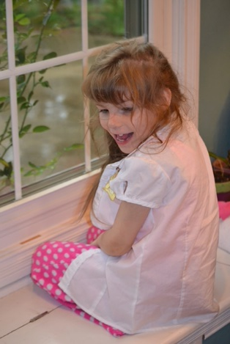
The new norm

Slide 8

Questions

